Slide 1
FPGA-Based Automatic License Plate Recognition System
Group 29
Dylan(Tianze) Zhang, Frank(Haofeng) Liu, Michal Ridner

Slide 2
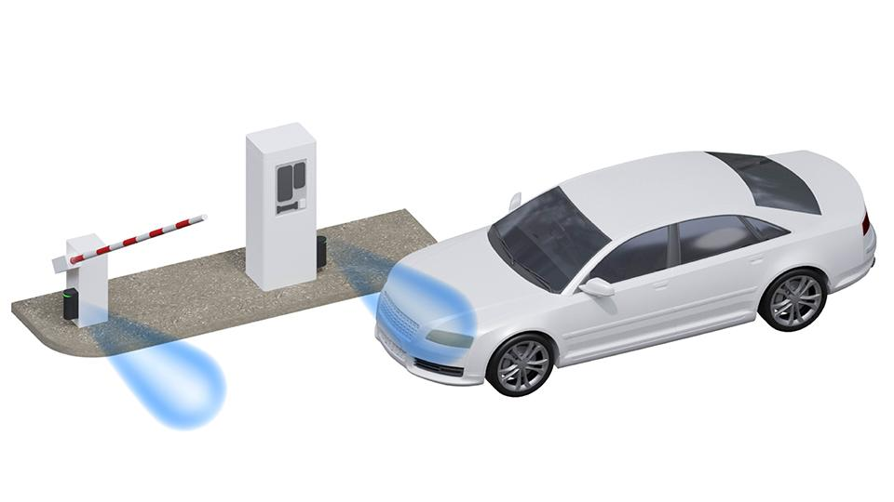
high-level project description
License Plate Recognition (LPR) is widely used in security, tolling, and parking systems.

Slide 3
Initial Goal:
Final Implementation
The objective of this project is to design and implement an FPGA-based device that captures a single frame from a camera upon a user pressing a physical button, detects and recognizes vehicle license plates, and subsequently controls gate access.
We met implement the license plate Recognition and Display the license plate using 7-segment Display Unit.

Slide 4
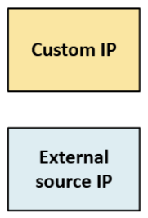
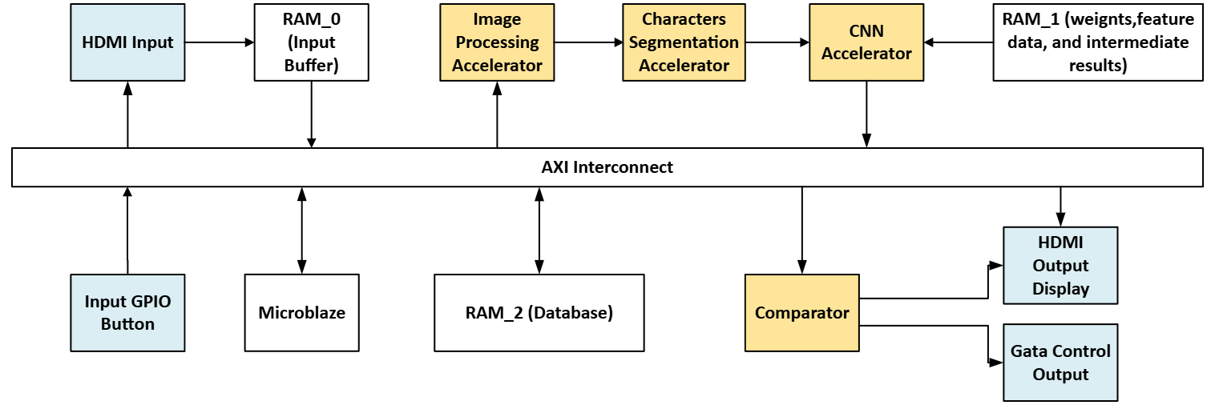
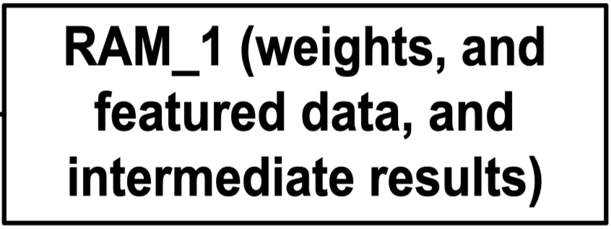
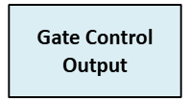
Initial Block Diagram

Slide 5
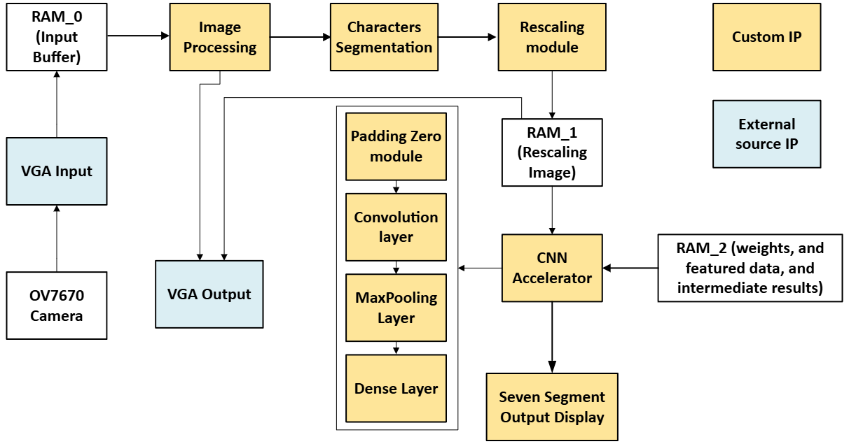
Final Block Diagram

Slide 6
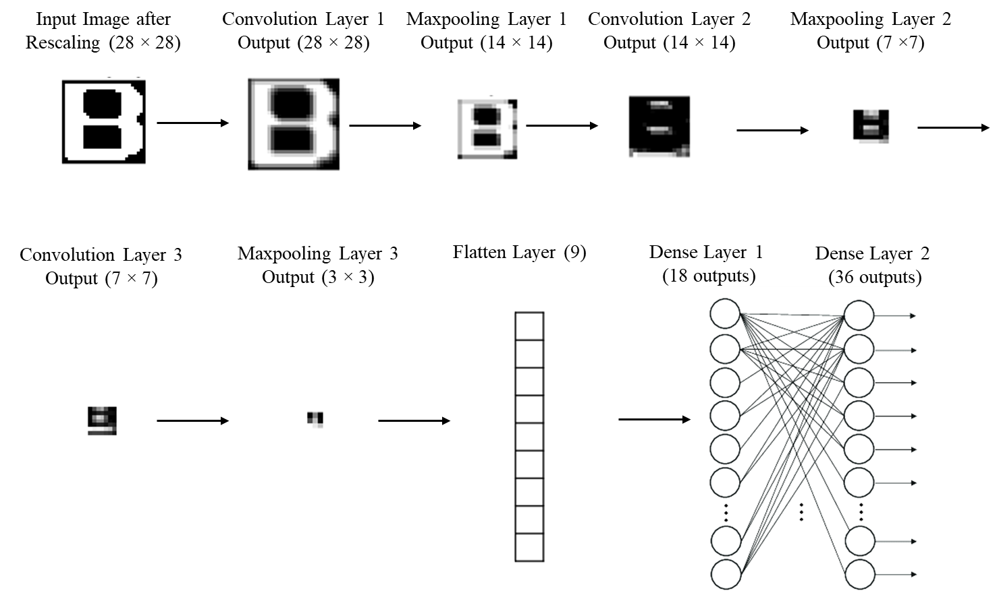
CNN Specifications
About 1000 parameters
Three Convolution Layers
Three Max pooling Layers
Two Dense Layers.

Slide 7
Major components
PMOD:
OV7670 Camera
Custom IP:
Segmentation
Rescaling
CNN module (includes Padding Zeros, Convolution Layer, Max Pooling Layer, Dense Layer)
7-Segment Display
3rd Party IP
VGA Camera Input (modified the RTL to grayscale the image for further processing)
VGA Output (adapted from 3rd party IP and made some modifications to fit our design)

Slide 8
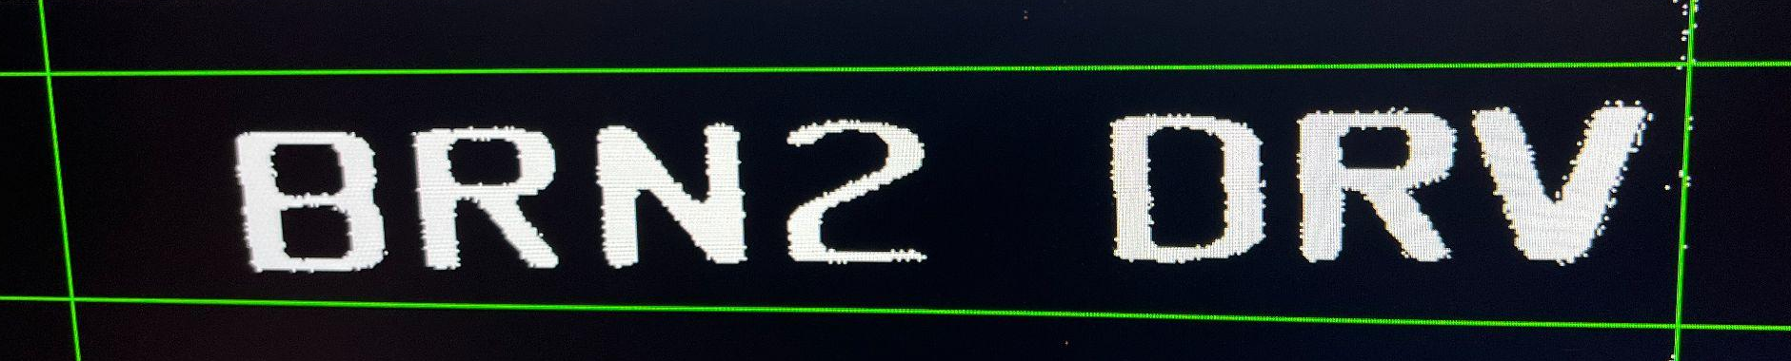
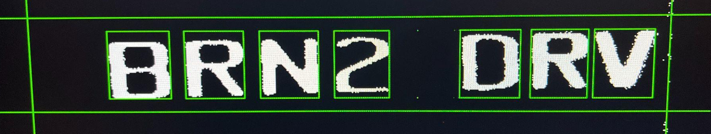
Segmentation module
Performs horizontal projection: detects top/bottom of license plate
Performs vertical projection: detects x-boundaries of characters
Finds 7 characters using histogram thresholds
Stores top_y, bottom_y, left_x, right_x for each character

Slide 9
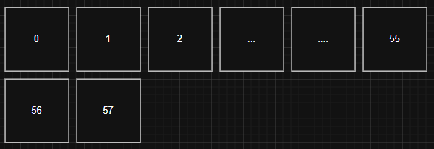


Rescaling Module
Uses a 2×2 window (top-left, top-right, bottom-left, bottom-right) from a line buffer FIFO
Each downsampled pixel = majority vote (2 or more out of 4 are white pixels → output 1)
FIFO keeps track of current and previous rows during scanning
28×28
56×56

Slide 10
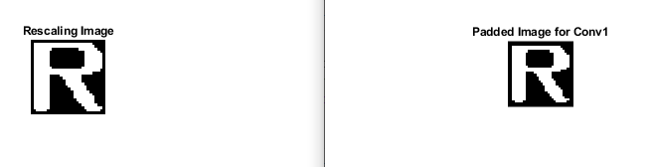
CNN module - Padding Zeros
Original image is embedded into the center of a (WIDTH+2) × (WIDTH+2) zero matrix
Pixel (x, y) in original becomes (x+1, y+1) in padded image

Slide 11
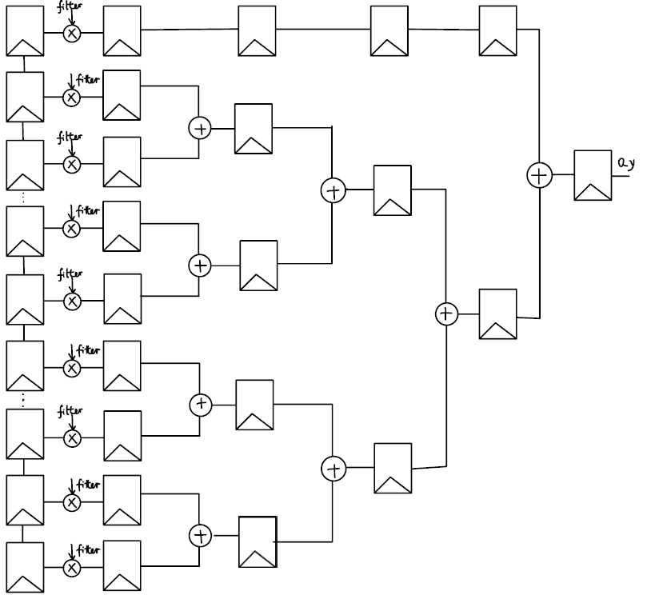
CNN module - Convolution
Maintains (3 rows + 3 pixels) of data using FIFO window Buffer, sliding 3×3 window convolution.
Sums 9 convolution products across 4 pipelined stages
Final result added to scaled bias and rounded. RELU function applied to the final result.
Fixed point representation used Q5.10 format. The intermediate multiplication results stored in Q11.20 format
Stage 4
Stage 3
Stage 2
Stage 1

Slide 12


Max pooling module
Similar to Rescaling module.
Compares all 4 pixels: outputs the maximum value instead of average value
28×28
14×14

Slide 13
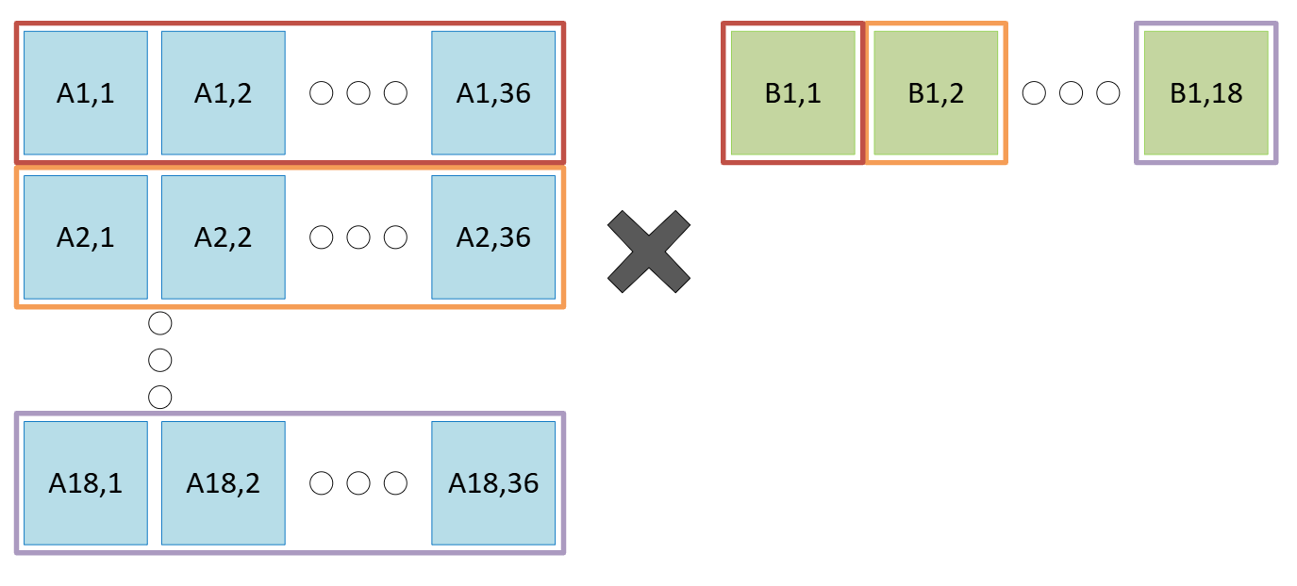
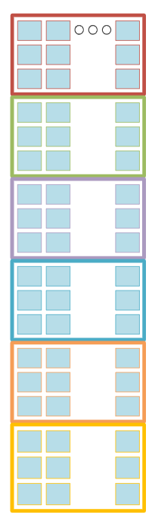
Dense Layer
Two Dense Layers:
9x18 weight matrix times 1x9 vector
18x36 weight matrix times 1x18 vector
Matrix-Vector Multiplication:
Step 1: weight[i][j] × input[i] → mult_matrix[i][j]
Step 2: mult_matrix[0][j] +...+ mult_matrix[18][j] → result_matrix[j]
Layer 2 Top-3 Prediction Logic:
Scans result_matrix[] to find highest 3 values and their indices

Slide 14
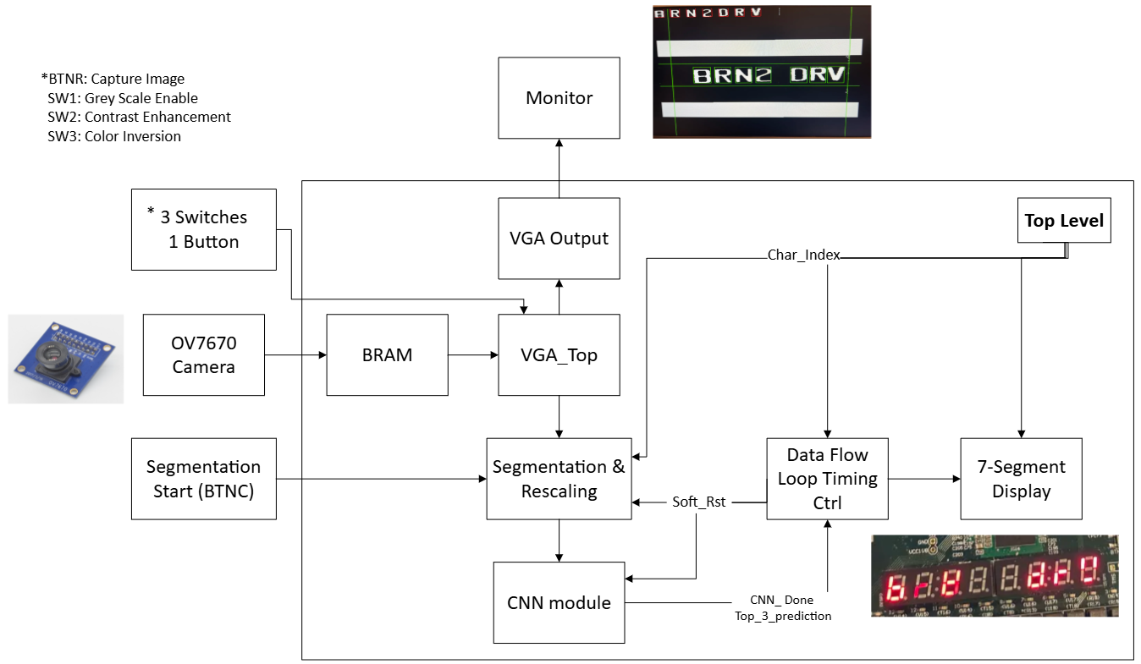
software flow in processor system

Slide 15
final computed difficulty score
Categories | Points
Use of VGA output + Grey Scaling (adapt with some open sources) | 0.75
OV7670 VGA Camera (adapt with some open sources) | 0.5
Segmentation IP Block | 1
Convolution layer (Pipeline input and output) IP Block | 1
Rescaling and Max Pooling layer (Pipeline input and output) IP Block | 1
Dense Layer IP Block | 0.5
Seven Segment Display | 0.2
Data Flow Loop Back Timing Control | 0.5
Total | 5.45

Slide 16
improvements given more time
Optimized the CNN models with better accuracy
Comparator module to check if the recognized license plate is authorized
Servo motor to mimic gate control if license plate is authorized
Add License Plate Detection Module to localize the license plate within the image before segmentation
Real time recognizing the license plate number with continuous video feed

Slide 17
Questions!

Slide 18
Thanks !!!

